Slide 1
Databases

Slide 2
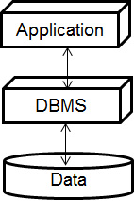
Introduction to Database Management Systems
A database management system (D B M S) is software that manages large collections of data
It is designed to store, retrieve, and manipulate data
A
application can interact with a D B M S through a 3-layer manipulation
Application: interacts with the user and sends instructions to D B M S
D B M S: works directly with the data and sends the result back to the application
Data: the data stored in D B M S

Slide 3
Tables, Rows, and Columns
Data stored in a database are organized into tables, rows, and columns
Each table holds a collection of related data
A table is a two-dimensional container made of rows and columns
A row is a complete set of information about a single item
A column holds an individual piece of information about the item
Name | Phone
Katie Allen | 555-1234
Kiran Sharma | 555-5678
Alex Prieto | 555-9012
Rosa Lopez | 555-3456
Ingrid Olen | 555-7890
Jamal Ramzi | 555-1122
Carmen Cabera | 555-3344
Sanjay Patel | 555-5566
Kelsey Rose | 555-2345
Each row contains data about one person

Slide 4
Column Data Types
When you create a database table, you must specify a data type for the column
Acceptable data types are defined by D B M S, not C#
The textbook uses Microsoft S Q L Server
S Q L Server Data Type | Description | Corresponding C# or . N E T Framework Data Type
bit | True/false values | bool
datetime | A date and a time | dateTime
decimal(t, d) | A decimal value with t total digits and d digits appearing after the decimal point. | decimal
float | Real numbers | double
int | An integer number | int
money | Values that represent currency | decimal
nchar(n) | A fixed-length Unicode string with a maximum length of n characters. | string
nvarchar(n) | A variable-length Unicode string with a maximum length of n characters. | string

Slide 5
Primary Keys and Identity Columns
Most database tables have a primary key
A primary key is a column that can be used to identify a specific row
The column that is designated as the primary key must hold a unique value for each row. For example:
Employee I D, social security number, invoice number, sales order number
Sometimes the data you want to store in a table does not contain any unique items that can be used as a primary key
You need to create a column specifically to serve as the primary key. This column is known as an identity column.
Identity columns typically contain integers
Each time a new row is added to the table, the D B M S automatically assigns a unique value to the identity column

Slide 6
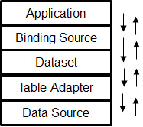
Creating a Database in Visual Studio
A . N E T application uses several components, arranged in layers, to connect to a database
Data Source – a source of data with which the application can work
Table Adapter – connects to a data source and retrieves data from a table in a data source
Dataset – gets a copy of a table from the table adapter and keeps the copy of the table in memory
Binding Source – a component that can connect user interface controls directly to a dataset

Slide 7
Creating a Server-Based Database
Visual Studio provides wizards that make it easy to create and configure the database
The Add New Item window provides a Service-based Database option for creating an empty S Q L Server database
The default name of the S Q L Server database is Database1.m d f
This book uses S Q L Server database for examples

Slide 8
The Database File's Location
When you use Visual Studio to create a S Q L server database, the database file will be created in the project's folder
The project's folder is where the Form1.cs, Form1.Designer.c s, and Program.cs files are stored
The file extension is .m d f. For example, Phonelist.mdf.
The server will also create a file that ends with the .L D F extension. For example, Phonelist_log.L D F.
This is a transaction log file used to keep a log of all the operations that you perform on the database

Slide 9
The DataGridView Control
A data-bound control is a user interface control that is connected to a data source
It automatically displays data from the data source and can be used to change the data
A DataGridView control is the simplest data-bound control and can display a database table in a scrollable grid

Slide 10
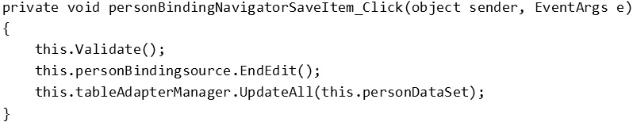
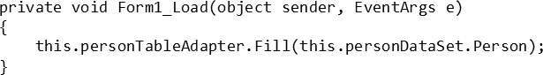
Auto-Generated Code
When you place a data-bound control, such as the DataGridView, on a form, the following code will be generated automatically:
These codes execute when the user clicks the Save button on the navigator bar
These codes apply any changes that have been made to the dataset and save them to the database
A Load event handler is also added to the form to call the table adapter's Fill method

Slide 11
Connecting to an Existing Database and Using Details View Controls
A Details view is a set of individual controls that are bound to the columns in a single row
Rather than showing multiple rows at once, a Details view lets the user see one row at a time
The Details view control is an alternative to the DataGridView control for interacting with a database

Slide 12
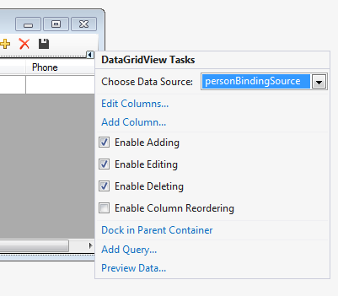
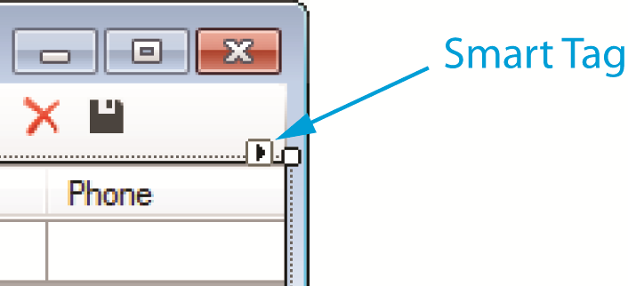
More About Data-Bound Controls
The DataGridView control and the Details view may be customized
In the Designer, if you select a DataGridView control, you will see a small arrow in the upper-right corner which is called a smart tag
If you click the smart tag, you will get a task panel with the following options:
Enable Adding – adds rows in the DataGridView
Enable Editing – changes the contents of rows
Enable Deleting – deletes rows
Enable Column Recording – allows users to click and drag columns to rearrange them

Slide 13
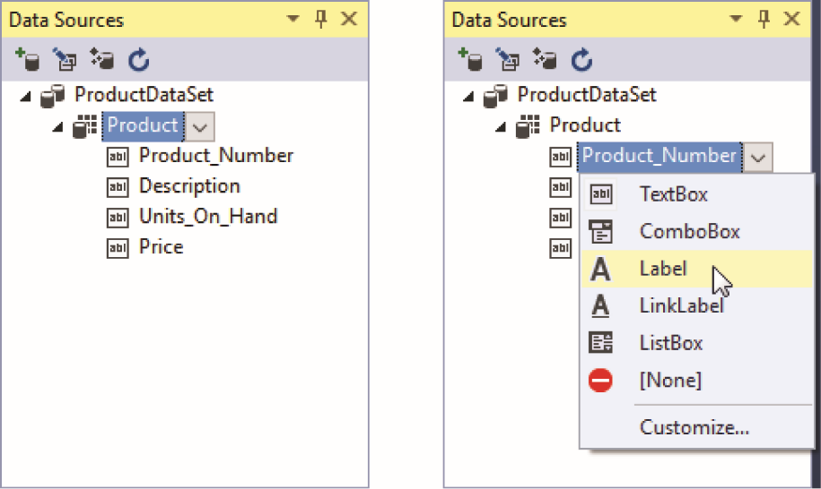
Customizing the Details View
By default, Details view controls are automatically bound in the following ways:
Columns containing character data are bound to TextBox controls
Numeric columns are bound to TextBox controls
Bit columns are bound to CheckBox controls
Datetime columns are bound to DateTimePicker controls
You can customize the type of control to which a column will be bound in the Data Source window

Slide 14
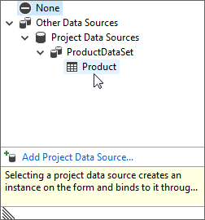
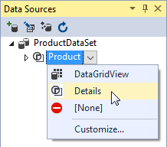
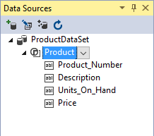
Binding Columns to ListBox Controls
You can bind a column to a ListBox control and display all the values in that column to be displayed in the list box
You need to use two of the ListBox control's properties:
DataSource: identifies the table from which the ListBox will get its data
DisplayMember: identifies the column

Slide 15
Selecting Data with the S Q L Select Statement
S Q L, short for structured query language, is a standard language for working with database management systems
S Q L statements consist of several keywords
You use these keywords to construct statements known as queries
Queries are sent to the D B M S as instructions to process data
The SELECT and FROM statements, for example, are used for retrieving the rows in a table. To retrieve the Description column for every row in the Product table, use:
S Q L is not case-sensitive
In this chapter, S Q L statements are part of the
applications you will create

Slide 16
The Select Statement
The SELECT statement allows you to select specific rows. Its generic form is:
To retrieve the Description and Price columns for every row in the Product table, use:
If you wish to retrieve every column in a table, use the * character

Slide 17
Specifying a Search Criteria with the Where Clause (1 of 2)
When you need to narrow the list down to few selected rows in the table, use the WHERE clause
The general format is:
in which Criteria is a conditional expression
S Q L supports several relational operators for writing conditional expressions

Slide 18
Specifying a Search Criteria with the Where Clause (2 of 2)
Operator | Meaning
> | Greater than
< | Less than
>= | Greater than or equal to
<= | Less than or equal to
= | Equal to
<> | Not equal to

Slide 19
Sample S Q L Statements (Where Clause)
To retrieve the product numbers and prices of all the items that are priced at $28.95:
To retrieve all the columns from only the rows where the description is 'Denim Jeans':
If you need to include a single quote as part of a string, write two single quotes. To search for 'Katy's Wool Cap', use:

Slide 20
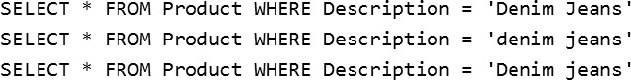
S Q L String Functions
SQL keywords and clauses are not case-sensitive but string comparisons are.
'Denim Jeans', 'denim jeans', and 'Denim jeans' are considered three different string literals
The following three SQL statements will generate three different results:
You can use the Lower() or Upper() string functions before performing the comparison

Slide 21
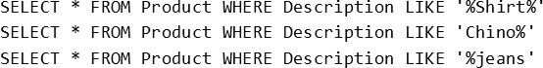
Using the LIKE Operator
The LIKE operator allows you to do a search based on a pattern rather than specifying exactly what is desired
'Oxford Cloth Shirt' and 'Poplin Shirt' both contains the string 'Shirt'
Use the string 'Shirt' as the pattern with the wildcard character %
% represents any sequence of zero or more characters
The underscore (_) wildcard character represents a single character. To search for all rows in which Product_Number begins with '2', followed by any one character, followed by '-0', followed by any one character, use:

Slide 22
Using Logical Operators
You can use the AND, OR, and NOT logical operators to specify multiple search criteria in a WHERE clause
The AND operator requires both search criteria be true for a row to be qualified as a match.
The OR operator requires that either of the search criteria be true for a row to be qualified as a match
The NOT operator is used to disqualify a search criteria

Slide 23
Sorting the Results of a Select Query
To sort the results of a SELECT query, use the ORDER BY clause
The results will be sorted in ascending order
To sort in descending order, use the Desc operator

Slide 24
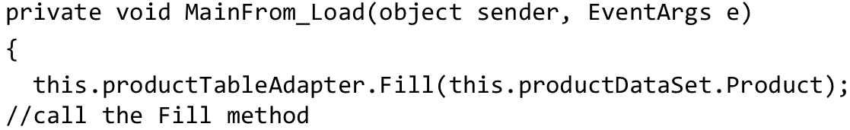
Table Adapter Queries (1 of 2)
A table adapter query is a S Q L statement that is stored in a table adapter and can be executed simply by calling a method
When you place a data-bound control, such as DataGridView, on a form, a Load event handler that calls the table adapter's Fill method is automatically created for the form
The above code calls the productTableAdapter's Fill method, passing the dataset's Product table as an argument
The Fill method also fills the dataset table with rows that are returned from a S Q L statement (described in the next slide)

Slide 25
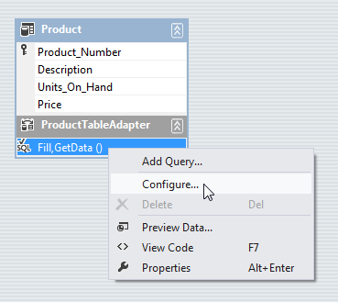
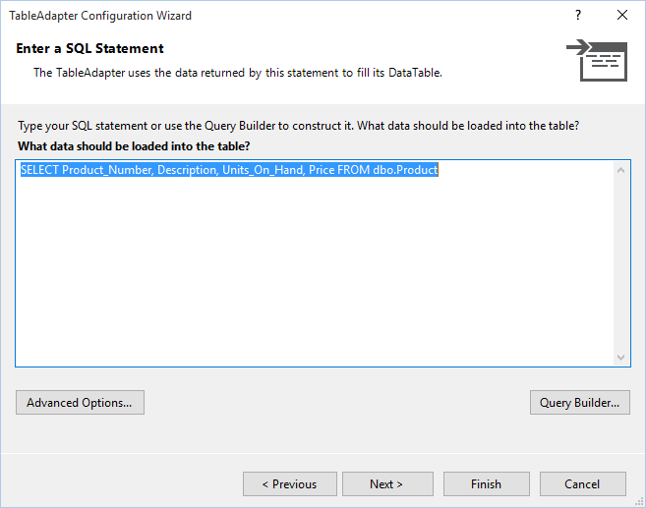
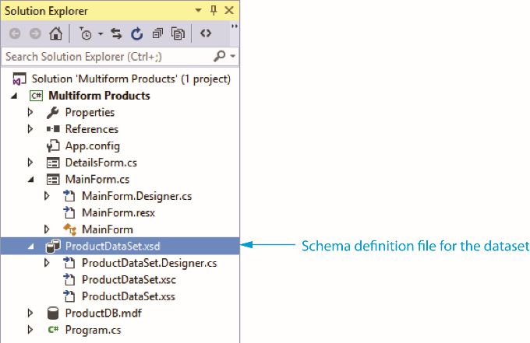
Table Adapter Queries (2 of 2)
In the Solution Explorer, you will see an entry named ProductDataSet.xsd which is the schema definition file that describes the contents of the productDataSet
Double-click the ProductDataSet.xsd entry to open it in an editor window
Right-click the area that reads Fill, GetData() and select Configure from the pop-up menu to display the Table Adapter Configuration Wizard
You can then add your own S Q L queries

Slide 26
S Q L Math Functions
S Q L provides several functions for performing calculations
Avg(Column): calculates the average value in a particular column
Sum(Column): calculates the sum of a column's values
Min(Column): finds the minimum value of a column.
Max(Column): finds the maximum value of a column
Count(Column): returns the number of values of the specified column
To determine the number of rows in a table, use:

Slide 27
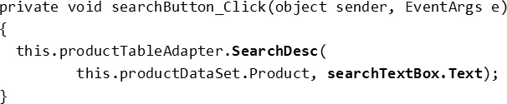
Query Parameters
SQL queries can accept arguments
Arguments are passed into parameter variables
In S Q L, a parameter variable begins with the @ symbol
The above statement retrieves all the rows in which the Price column is less than the value of the priceValue parameter
When you call the table adapter method for a S Q L query, you have to pass arguments for any parameters that are used in the query
The above code calls the table adapter's SearchDesc method
The 2nd argument is the searchTextBox control's Text property

